Slide 1
The Euro Interbank Repo Market
Loriano Mancini
EPFL - SFI
Angelo Ranaldo
University of St. Gallen
Jan Wrampelmeyer
University of St. Gallen
American Finance Association Meetings
January 4, 2016, San Francisco, CA

Slide 2
Why should we study repo markets?
Introduction
Setting
Data
Results
Conclusion
Repos are predominant form of short-term funding
The market structure is crucial for the fragility of funding markets (Martin, Skeie, and von Thadden, 2014a)
Is there a market design ensuring that banks can always satisfy liquidity needs?
Is there a market design encouraging lending even in distressed periods?
Which characteristics make a repo market resilient?

Slide 3
Why should we study the euro repo market?
Introduction
Setting
Data
Results
Conclusion
It has a unique structure including key characteristics:
Anonymous CCP-based trading
Haircuts are set by the CCP and are thus exogenous to repo traders
Relatively safe collateral securities
No daily unwind
It helps understand which market features are key for repo market stability

Slide 4
Theoretical predictions
Introduction
Setting
Data
Results
Conclusion
The basic prediction is that banks reduce lending in crisis times e.g., with higher
Aggregate risk (Allen, Carletti, and Gale, 2009),
Knightian uncertainty (Caballero and Krishnamurthy, 2008),
Lenders' rollover risk (Acharya and Skeie, 2011),
Informational frictions (e.g., Stiglitz and Weiss, 1981),
Risk of fire sales (Diamond and Rajan, 2011).
But how the main characteristics contribute to market stability?

Slide 5
Does CCP improve market stability?
Introduction
Setting
Data
Results
Conclusion
No direct counterparty exposures; smaller risk of re-sales of collateral; orderly liquidates collateral (Oehmke 2014) and distributes losses in case of default of a participating bank
But larger concentration of credit and operational risks (Singh 2014); moral hazard (Biais, Heider, and Hoerova, 2012); no opportunity of bilateral netting across different contracts (Duffie and Zhu, 2011)
1/12

Slide 6
Do dynamic haircuts improve market stability?
Introduction
Setting
Data
Results
Conclusion
Haircuts should adjust with the volatility of collateral securities (e.g. Brunnermeier and Pedersen 2009); informational insensitive (Gorton and Ordoñez 2014); help distressed borrowers to receive funding (MSvT 2014a)
But trigger run on repos (Gorton and Metrick 2012)

Slide 7
The daily unwind
Introduction
Setting
Data
Results
Conclusion
The daily unwind undermines market stability (MSvT 2014a)
But is its removal sufficient for market stability?

Slide 8
Our contribution
Introduction
Setting
Data
Results
Conclusion
A priori unclear whether Euro repo interbank market is fragile given that no previous theoretical or empirical paper provides a joint analysis of these market features
This paper fills this gap by providing the first systematic study of the euro interbank repo market
Comparing the characteristics and development of different repo markets in the United States and Europe, we highlight which characteristics fosters money market stability.

Slide 9
What we find
Introduction
Setting
Data
Results
Conclusion
The CCP-based euro interbank repo market was resilient
In contrast to the basic prediction
In contrast to non-CCP-based euro repo market
In contrast to the repo markets in the United States
The importance of collateral quality
Weaker resilience for repos with relatively riskier collateral
Repos secured by safest securities act as shock absorber
The comparative analysis suggests that
Safe collateral is necessary but not sufficient for resilience
The three joint characteristics (anonymous CCP, safe collateral, and no unwind) achieve resilience

Slide 10
Our contribution to the literature
Introduction
Setting
Data
Results
Conclusion
Repo literature
U.S. repos (Gorton and Metrick, 2012; Krishnamurthy, Nagel, and Orlov, 2014; Copeland, Martin, and Walker, 2014)
CCP (e.g., Duffie and Zhu, 2011; Capponi, Cheng, and Rajan, 2015)
Unconventional monetary policy (UMP)
Effects of UMP (e.g., Freixas, Martin, and Skeie, 2011; Drechsler, Drechsel, Marques, and Schnabl, 2014; Eser and Schwaab, 2014; Giannone et al., 2012)
Substitution effect from "private" to "public" liquidity (Bolton, Santos, and Scheinkman, 2009)

Slide 11
Institutional background
Contribution
Setting
Data
Results
Conclusion

Slide 12
Institutional background
Contribution
Setting
Data
Results
Conclusion
19%
10%
71%
Eurex
Bktec
MTS

Slide 13
Safeguards
Contribution
Setting
Data
Results
Conclusion
Participants have to meet a number of criteria to be deemed eligible for clearing membership by the CCP
Be subject to a financial market supervisory authority in their country of domicile
Meet minimum capital requirements
Contribute to the clearing fund
Fulfill regular stress tests or meet credit rating requirements
CCPs lines of defense
Collateral policy (e.g. Eurex: ECB’s eligible at least A-/A3)
Anonymity: lenders does not learn about borrowers’ default
Other market participant can only be affected by the default if the CCP has to draw on the clearing fund
Before it: position closeout, liquidation of collateral, exhaustion of the clearing fund contribution, CCP’s reserves
Notes:
Aggregation
average (standardized) CS, Roll and Gibbs to get one LF liquidity proxy (per exchange rate)
average over exchange rates to get a systematic (global) liquidity proxy

Slide 14
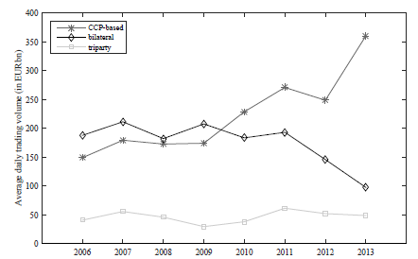
Volume across segments of Euro interbank market
Contribution
Setting
Data
Results
Conclusion

Slide 15
Market figures: 2006 – 2014 CCP repos
Contribution
Setting
Data
Results
Conclusion
 | Volume EURtn | Share in %
BrokerTec | 314 | 67
Eurex | 64 | 14
MTS | 87 | 19
GC | 152 | 27
Specials | 339 | 73
1-day | 447 | 96
Longer | 18 | 4

Slide 16
Sample
Contribution
Setting
Data
Results
Conclusion
Data for all three platforms:
Jan 2006-Feb 2013; focus on one-day tenor (o/n, t/n, s/n)
Eurex Data
Leading electronic trading platform for euro GC repos
All trades: 109,473 trades, EUR 33 trillion of traded volume
Repo rate, trade volume, collateral basket
Time: exact time stamp; purchase and repurchase dates
BrokerTec and MTS
Majority of trading volume in specials
Daily RepoFunds Rate (RFR) indices for German, French, and Italian collateral (top 3 countries -> 80% of market share)
MTS repos mostly rely on Italian government securities

Slide 17
Repo rates
Contribution
Setting
Data
Results
Conclusion
Repo spread:
Main message:
No significant increase in repo spreads, even in distressed periods

Slide 18
Repo volume
Contribution
Setting
Data
Results
Conclusion
Main message:
Increasing volume, in contrast to (1) unsecured lending, (2) non-CCP-based Euro repos, and (3) U.S. repo markets
Decline after 3-year LTROs (Dec 2011 and Feb 2012)

Slide 19
Term maturity
Contribution
Measures
Data
Results
Conclusion
Main message:
Increasing, suggesting repo traders did not reduce risk exposure by shortening maturity
In contrast to U.S. repos (Gorton, Metrick, and Xei, 2012)

Slide 20
Haircuts
Contribution
Measures
Data
Results
Conclusion
Haircuts are set by CCP and derived from ECB rules
Lenders cannot increase haircuts to mitigate risk
Riskier securities not eligible for Eurex GCP

Slide 21
Haircuts
Contribution
Setting
Data
Results
Conclusion
Eurex excludes
Italian securities
Number eligible securities
Volume weighted haircuts
Haircuts of eligible securities
ECB extends list of eligible securities
Crisis measures expire and get partly reinstated
Main message:
Volume-weighted average haircuts rather stable over time

Slide 22
Drivers
Contribution
Setting
Hypotheses
Results
Conclusion
What drives repo spreads, volumes, and terms?
No comprehensive theoretical model, but main drivers can be:
Risk
CISS (Hollo, Kremer, and Lo Duca, 2012)
Other measures: LIBOIS, iTraxx, TARGET GER/GIIPS, VSTOXX, 10ySpread ESP-GER or ITA-GER
Incentives to trade
Haircut ratio to capture attractiveness of public liquidity relative to private liquidity (Avg. HC ECB / Avg. HC Eurex)
Central bank policy
Steering of expectations about future target rates
Liquidity provision

Slide 23
Excess liquidity
Contribution
Setting
Hypotheses
Results
Conclusion
Excess liquidity (ECB’s definition):
Credit institutions’ current account holdings at the ECB + Funds in the ECB deposit facility - Reserve requirements

Slide 24
Regression analysis
Contribution
Setting
Data
Results
Conclusion
LS regressions with HAC standard errors.
Sub-sampling to account for the switch from VRA to FRFA operations (15/10/2008)
Weekly time series in level and changes
Past values for regressors to eliminate endogeneity issues
A time trend in the volume equation to allow for linear growth
A dummy variable to capture the EUR 300 billion threshold

Slide 25
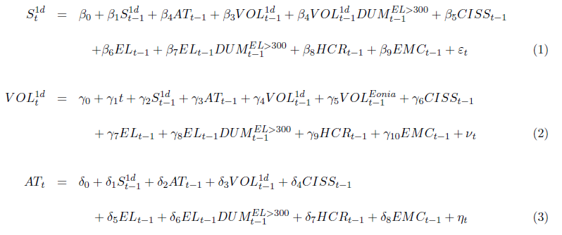
Regression analysis
Contribution
Setting
Data
Results
Conclusion

Slide 26
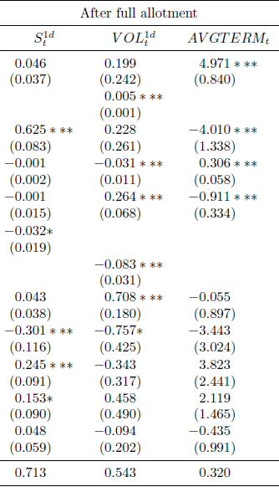
Regression analysis for the GCP ECB basket
Contribution
Setting
Data
Results
Conclusion
Support to the shock absorber hypothesis: Repo volume and risk positively related; Spreads and term insensitive to risk

Slide 27
Regression analysis for the GCP ECB basket
Contribution
Setting
Data
Results
Conclusion
Substitution from unsecured lending to secured lending

Slide 28
Regression analysis for the GCP ECB basket
Contribution
Setting
Data
Results
Conclusion
More attractive ECB haircut policy (more conservative CCP policy), smaller repo spread

Slide 29
Regression analysis for the GCP ECB basket
Contribution
Setting
Data
Results
Conclusion
Moderate EL: higher EL, lower spreads
Saturation: no change in rates; volume ↓

Slide 30
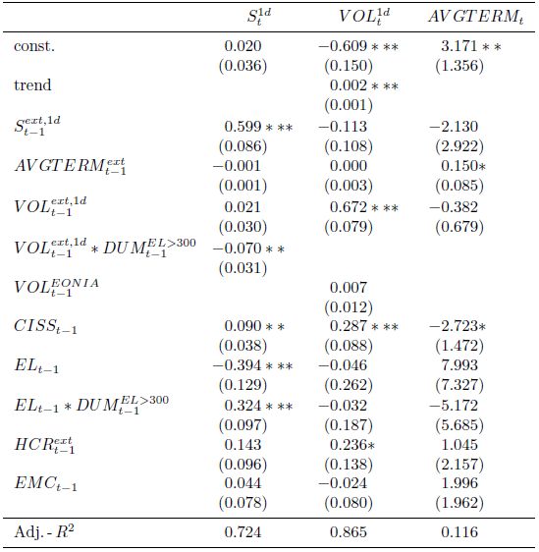
Comparison of collateral baskets
Contribution
Setting
Data
Results
Conclusion
ECB EXTended basket is riskier than the ECB basket
No substitution from unsecured
Less resilient

Slide 31
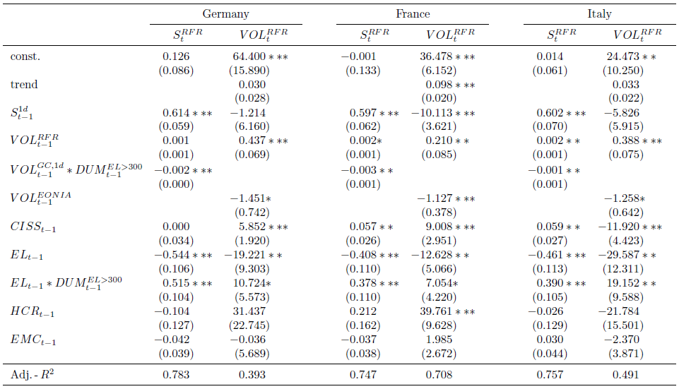
Other CCP-based platforms: Bktec / MTS
Contribution
Setting
Data
Results
Conclusion
The safety of collateral is a necessary condition for the resilience of the repo market

Slide 32
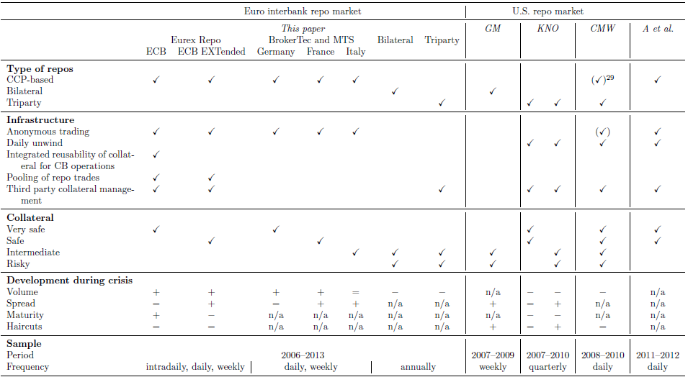
Which characteristics make a repo market resilient?
Contribution
Setting
Data
Results
Conclusion

Slide 33
Concluding remarks
Contribution
Setting
Data
Results
Conclusion
The CCP-based euro interbank repo market is the most resilient market structure
With very safe collateral, even shock absorber
Resilience stems from three joint characteristics:
An anonymous CCP-based infrastructure
Safe collateral
The absence of the unwind mechanism
Each of these characteristics taken separately is a necessary rather than sufficient condition

Slide 34
Policy implications
Contribution
Setting
Data
Results
Conclusion
Europe: more stability of the Euro money market by endorsing CCP-based repos as substitutes for unsecured loans and bilateral repos
U.S.: the GCF segment of the triparty market already incorporates two out of the three main characteristics for resilience, i.e., anonymous CCP-based trading and safe collateral
The next crucial step is the removal of remaining issues related to the unwind mechanism
The identification of the key drivers of repo market activity facilitates banks' liquidity and risk management
The identification of the “saturation” threshold is important for monetary policy

Slide 35
Appendix
State variables
GCP volumes
Excess Liquidity and lending volume
Descriptive statistics
Term spread
Volatility
Market liquidity
Number of active market participants
The CCP-based repo market infrastructure

Slide 36
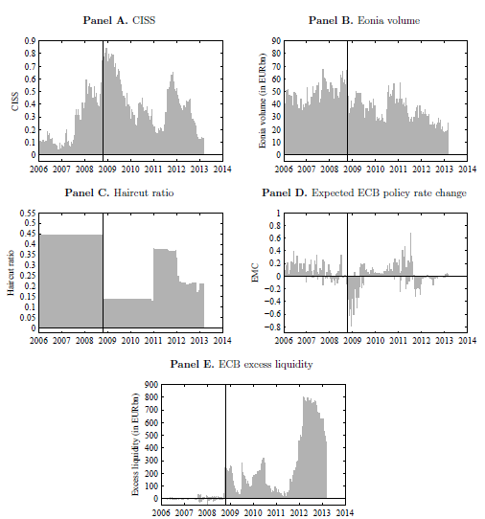
State variables
Appendix

Slide 37
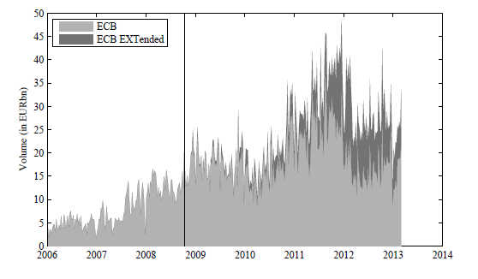
GCP volumes
Appendix

Slide 38
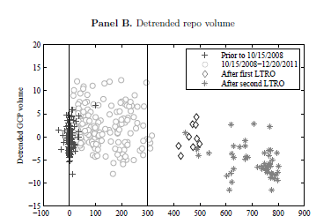
Excess Liquidity and lending volume
Appendix

Slide 39
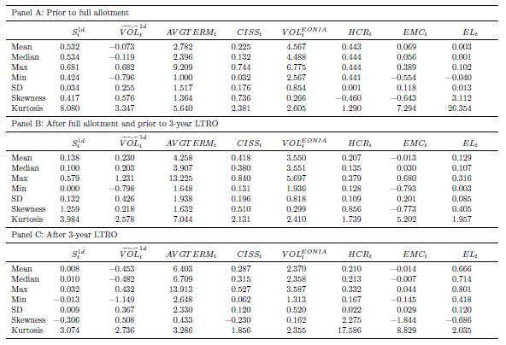
Descriptive statistics
Appendix

Slide 40
Term spread
Appendix

Slide 41
Volatility
Appendix

Slide 42
Market liquidity
Appendix

Slide 43
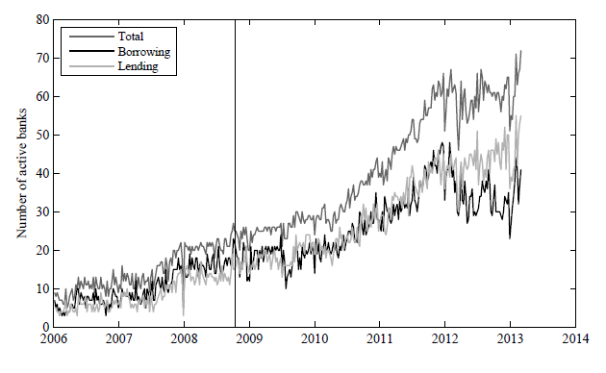
Number of active market participants
Appendix

Slide 44
The CCP-based repo market infrastructure
Appendix
Common features of Eurex Repo, BrokerTec, and MTS
All platforms facilitate anonymous trading via CCPs that are authorized as central counterparties under the European Markets Infrastructure Regulation (EMIR).
The CCPs are regulated by the local regulators and central banks in the countries in which they operate.
Participants have to meet a number of criteria to be deemed eligible for clearing membership by the CCP.
Repos with a maturity longer than one day are true term repos in the sense that there is no daily unwind mechanism as in the United States.

Slide 45
The CCP-based repo market infrastructure (2)
Appendix
Eurex Repo
The leading electronic trading platform for euro GC repos
GC Pooling repos constitute the vast majority of repo volume (more than 85%)
A transparent electronic order book with binding quotes that are displayed per term/collateral combination, including volume.
More than 115 international participants from 12 countries
CCP: Eurex Clearing AG (owned by Deutsche Boerse Group); Clearstream: collateral management and settlement
GCP ECB basket, collateral reusable for refinancing within the framework of ECB/Bundesbank open market operations and for further transactions in the Eurex Repo GCP system (EXTended basket only at BuBa).
Settlement: three times a day; it determines net borrowers / lenders.

Slide 46
The CCP-based repo market infrastructure (3)
Appendix
BrokerTec and MTS
Operated by ICAP plc.
Vast majority of repos traded on BrokerTec and MTS (about 80%) are specials.
MTS: main collateral is Italian gov. securities.
BrokerTec and MTS link to several CCPs, namely LCH.Clearnet LTD, LCH.Clearnet SA, and Cassa di Compensazione e Garanzia (CC&G).
Bilateral collateral management, i.e., the counterparties select the securities that are to be delivered as collateral by themselves.
No integrated re-usability for central bank operations or a pooling of collateral.

