Slide 1
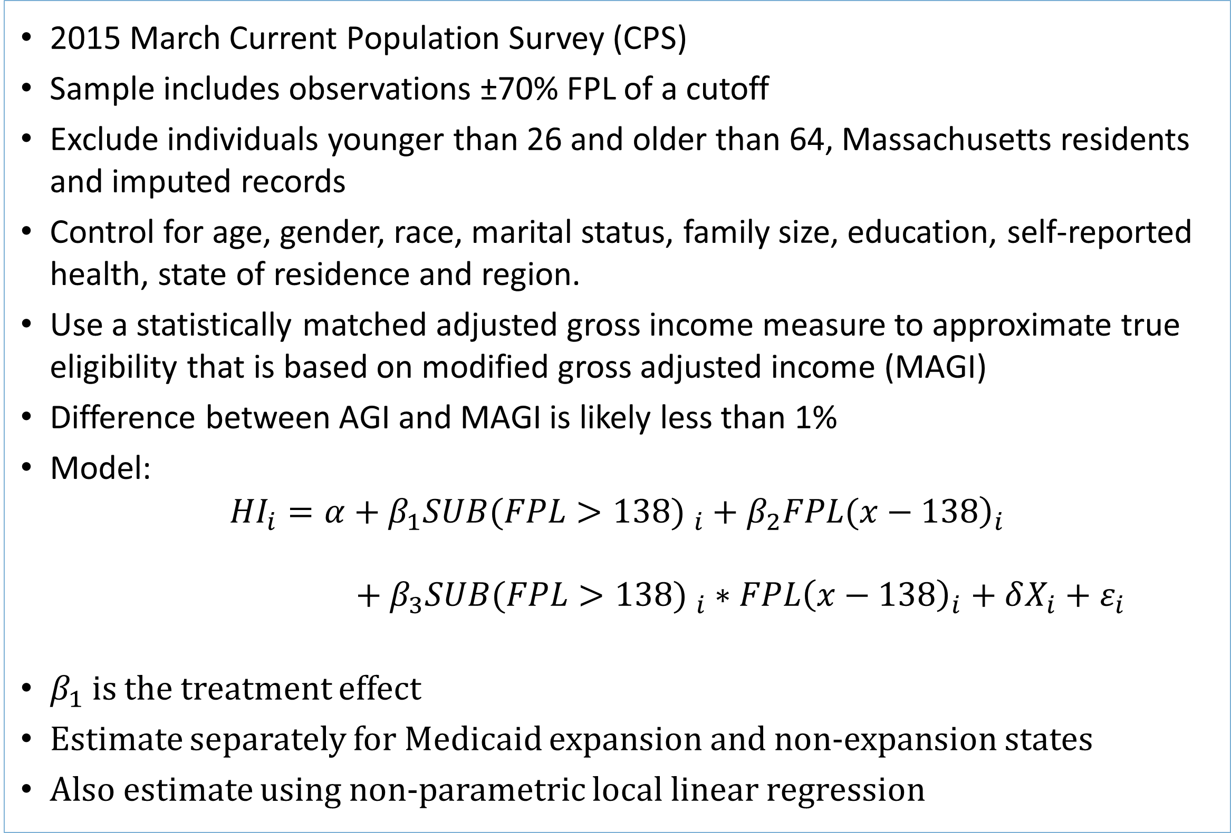
Incentive(less)? The Effectiveness of Tax Credits and Cost-Sharing Subsidies in the Affordable Care Act
Jesse Hinde
University North Carolina at Chapel Hill, Department of Public Policy
Policy Question and Contribution
Figure 2. Manipulation Tests
Advance premium tax credits and cost-sharing reductions vary between 100% and 400% FPL
Do the advance premium tax credits and cost-sharing reductions increase non-group private coverage in 2014?
  Which subsidy(s)?
  Use regression discontinuity to exploit discrete differences in subsidy levels
Provides a more general estimate of the price-responsiveness of low-income adults
Expansion States
Non-expansion States
Table 1. ACA Advance Premium Tax Credits
Results
FPL | Single Income | % Premium Cap | Max Annual Premium | Max Monthly Premium
100% | $11,490 | 2% | $230 | $19
138% | $15,856 | 3% | $475 | $40
250% | $28,725 | 8.05% | $2,312 | $193
400% | $45,960 | 9.5% | $4,366 | $363
No statistical evidence of income manipulation
No significant effects for any, employer-sponsored, or public coverage
4.8 to 5.6 percentage point effect for individually purchase insurance (IPI) above 138% FPL in expansion states (p<0.05)
Weak or no effects for IPI at higher cutoffs
  250% FPL: no evidence of a cost-sharing-specific effect
  400% FPL: weak evidence for tax credit-specific effect
  Indirectly suggests tax credits are the key component
No significant effects in non-expansion states on IPI
Average tax credit in 2014 was approximately $3,000
Approach
Regression discontinuity using FPL cutoffs
  Compare individuals with approximately equal incomes but different program eligibility
  100/138% FPL (gain both incentives)
  250% FPL (lose cost-sharing reductions)
  400% FPL (lose tax credits)
Argue that the cutoffs are exogenous with prospective enrollment and payback penalty
Avoids contamination of other ACA policies
Figure 3. Main Results for Any Health Insurance
Expansion States
Non-expansion States
Figure 1. Relative Tax Credit Value
Table 2. ACA Cost-sharing Reductions
FPL Range | Increased Actuarial Value
100-150% | 94%
150-200% | 87%
200-250% | 73%
Figure 4. Main Results for IPI
Non-expansion States
Expansion States
Benchmarked to silver plan (70%)
Data and Methods
2015 March Current Population Survey (CPS)
Sample includes observations ±70% FPL of a cutoff
Exclude individuals younger than 26 and older than 64, Massachusetts residents and imputed records
Control for age, gender, race, marital status, family size, education, self-reported health, state of residence and region.
Use a statistically matched adjusted gross income measure to approximate true eligibility that is based on modified gross adjusted income (MAGI)
Difference between AGI and MAGI is likely less than 1%
Model:
$${HI}_{i}=α+β_{1}{SUB(FPL>138) }_{i}+β_{2}{\left.FPL(x−138\right)}_{i}$$
$$+ β_{3}{SUB(FPL>138) }_{i}∗{FPL\left(x−138\right)}_{i}+δX_{i}+ε_{i}$$
$β_{1}$ is the treatment effect
Estimate separately for Medicaid expansion and non-expansion states
Also estimate using non-parametric local linear regression
Policy Implications
No crowd-out at 138% FPL
  Do consumers prefer a highly subsidized IPI plan (but with cost-sharing) over Medicaid?
  Is this potentially cheaper for the federal government?
Large elasticity estimate of -0.65 to -0.58
  Compared to -0.6 to -0.3 for self-employment subsidies
  Compared to -0.41 to -0.27 for COBRA subsidies
  Low-income individuals may be more price-responsive
  Suggests tax credit level need to be raised to increase participation at higher income levels
Emphasis on state support and the coverage gap below 100% FPL
  Increased advocacy/outreach
  Enrollment assistance
  Direct transition from Medicaid to IPI
  Technical issues with Healthcare.gov
Contact
Jesse Hinde
Email: hinde@live.unc.edu
Website: http://jessehinde.web.unc.edu/

