Slide 1
IMPROVING MEDICAL MARKETS:
Kidney Exchange, and the Market for New Doctors
Alvin E. Roth
Stanford University
Congressional briefing on the role of economic research in health policy:
Friday, April 12, 2013
12:00 pm – 1:30 pm
Rayburn House Office Building Room B-338

Slide 2
How do markets work?
Commodity markets are relatively simple:
You pay your money and you take your choice: buyers choose what they want from what they can afford.

Slide 3
Other kinds of markets aren’t so simple:
There are lots of things you can’t simply choose, you also have to be chosen.
  Jobs
  Schools
  Organ transplants
  Spouses
Some of these “matching” markets don’t even use money, and even in those that do, money has a different role than in markets for commodities

Slide 4
Clearinghouses
Clearinghouses are important because, to work well, markets need to
Establish thickness
Deal with congestion
Be safe to participate in
I’ll tell you briefly today about how clearinghouses help do that in
The American market for doctors
Kidney Exchange

Slide 5
Kidney exchange--background
There are 95,846 patients on the waiting list for cadaver kidneys in the U.S. (as of Wednesday, 4/10/12)
In 2012 34,841 patients were added to the waiting list, and 28,423 patients were removed from the list, 10,851 for deceased donor transplants and 5090 for live donor transplants.
In the same year, 4,170 patients died while on the waiting list (and more than 2,267 others were removed from the list as “Too Sick to Transplant”.
In 2012 there were 5,619 total transplants of kidneys from living donors in the US, and 10,868 total transplants from deceased donors.
Sometimes donors are incompatible with their intended recipient.
This opens the possibility of exchange .

Slide 6
6

Slide 7
Section 301 of the National Organ Transplant Act
(NOTA), 42 U.S.C. 274e 1984 states:
“it shall be unlawful for any person
to knowingly acquire, receive or otherwise transfer any human organ for valuable consideration for use in human transplantation”.
Legal opinion obtained by the transplant community interpreted this as forbidding buying and selling, but allowing exchange. But the DOJ wasn’t sure…

Slide 8
Charlie W. Norwood Living Organ
Donation Act
Public Law 110-144, 110th Congress, Dec. 21, 2007
Section 301 of the National Organ Transplant Act (42 U.S.C. 274e) is amended--in subsection (a), by adding at the end the following:
``The preceding sentence does not apply with respect to human organ paired donation.''
8

Slide 9
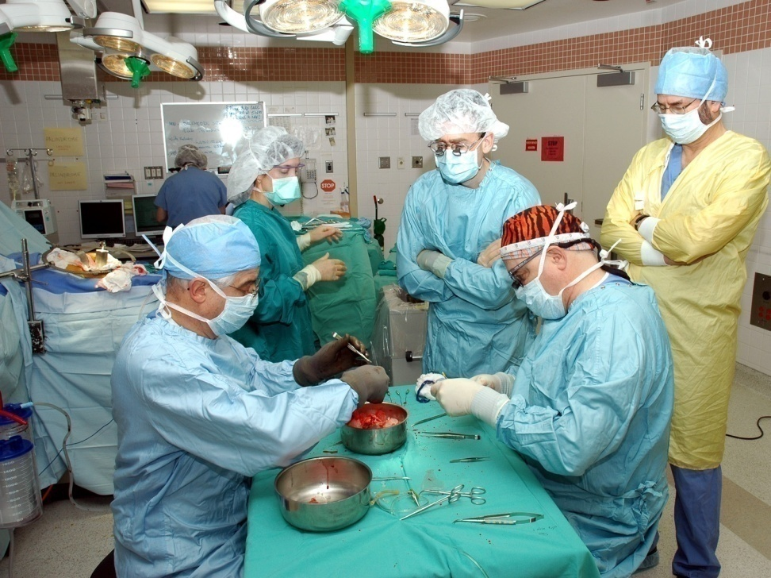
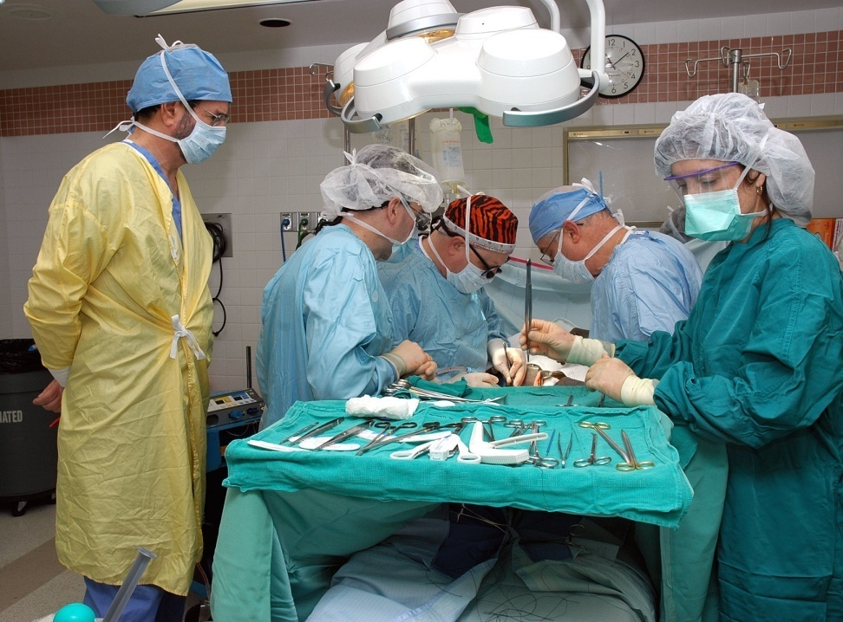
“Kidney exchange” is an in-kind exchange
A simultaneous exchange between two pairs requires 4 operating rooms and surgical teams, for two nephrectomies and 2 transplants
9
Notes:
9

Slide 10
Economists and surgeons collaborated to get around the simultaneity requirement
Non-simultaneous chains can be initiated by a non-directed donor…
  and can accomplish many more transplants than could be managed if all the operating rooms had to be available simultaneously and staffed by separate surgical teams.

Slide 12
The First NEAD Chain (Rees, APD)
July
July
Sept
Sept
Feb
Feb
Feb
Feb
March
March
2007
2007
2007
2007
2008
2008
2008
2008
2008
2008
MI
AZ
OH
OH
OH
MD
MD
MD
NC
MD
OH
1
2
3
4
5
6
7
8
9
10
O
O
A
A
B
A
A
A
AB
A
AB
O
O
A
A
B
A
#
A
A
A
*
A
Recipient PRA
62
0
23
0
100
78
64
3
100
46
Recipient Ethnicity
Cauc
Cauc
Cauc
Cauc
Cauc
Hisp
Cauc
Cauc
Cauc
AA
Relationship
Husband
Wife
Mother
Daughter
Daughter
Mother
Sister
Brother
Wife
Husband
Father
Daughter
Husband
Wife
Friend
Friend
Brother
Brother
Daughter
Mother
* This recipient required desensitization to Blood Group (AHG Titer of 1/8).
# This recipient required desensitization to HLA DSA by T and B cell flow cytometry.

Slide 13
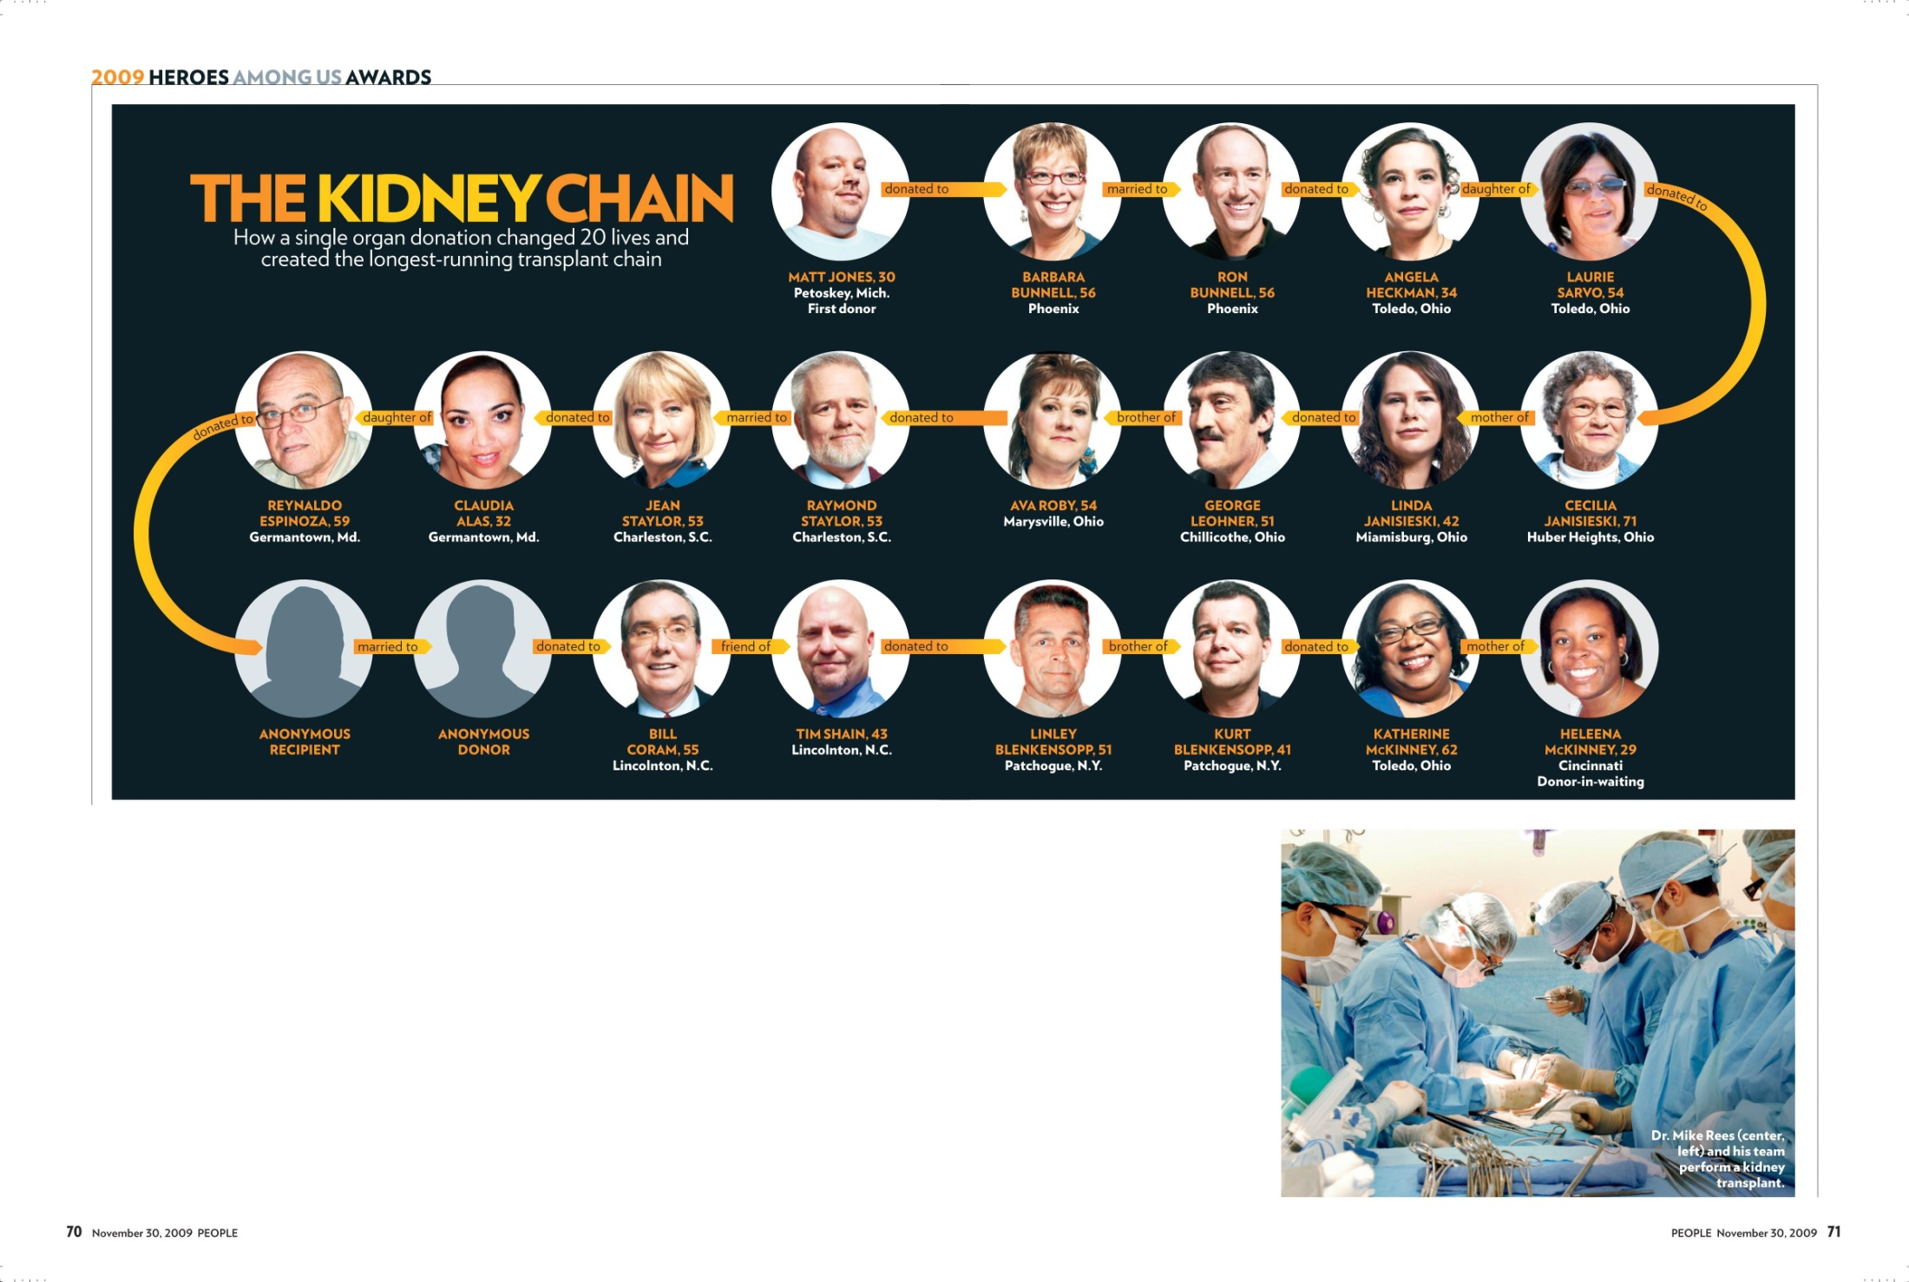

Slide 14

Feb 2012: a NEAD chain of length 60
(30 transplants)

Slide 15
It’s not only patients who need to be matched
The medical labor market uses a carefully designed labor market clearinghouse, through which American doctors get their first jobs

Slide 16
Matching doctors to first positions in U.S.
The redesign in 1995 of the
  National Resident Matching Program (NRMP) (approx. 23,000 positions, 500 couples)
The redesign in 2005 of fellowship matches for more senior physicians
  The Gastroenterology fellowship match

Slide 17
Background to redesign of the medical clearinghouses
1900-1945 UNRAVELLING OF APPOINTMENT DATES
1945-1950 CHAOTIC RECONTRACTING--Congestion
1950-197x HIGH RATES OF ORDERLY PARTICIPATION
( 95%) in centralized clearinghouse
197x-198x DECLINING RATES OF PARTICIPATION (85%) particularly among the growing number of MARRIED COUPLES
1995-98 Market experienced a crisis of confidence with fears of substantial decline in orderly participation;
  Design effort commissioned—to design and compare alternative matching algorithms capable of handling modern requirements: couples, specialty positions, etc.
  Roth-Peranson clearinghouse algorithm adopted, and employed

Slide 18
What makes a clearinghouse successful or unsuccessful?
A matching is “stable” if there aren’t a doctor and residency program, not matched to each other, who would both prefer to be.
Hypothesis: successful clearinghouses produce stable matchings.
How to test this?

Slide 19
Market Stable Still in use (halted unraveling)
NRMP yes yes (new design in ’98)
Edinburgh ('69) yes yes
Cardiff yes yes
Birmingham no no
Edinburgh ('67) no no
Newcastle no no
Sheffield no no
Cambridge no yes
London Hospital no yes
Medical Specialties yes yes (~30 markets, 1 failure)
Canadian Lawyers yes yes (Alberta, no BC, Ontario)
Dental Residencies yes yes (5 ) (no 2)
Osteopaths (< '94) no no
Osteopaths (> '94) yes yes
Pharmacists yes yes
Reform rabbis yes (first used in ‘97-98) yes
Clinical psych yes (first used in ‘99) yes
Lab experiments yes yes.
(Kagel&Roth QJE 2000) no no
Lab experiments fit nicely on the list, just more of a variety of observations that increase our confidence in the robustness of our conclusions, the lab observations are the smallest but most controlled of the markets on the list…

Slide 20
Stable Clearinghouses (those now using the Roth Peranson Algorithm)
  NRMP / SMS:
Medical Residencies in the U.S. (NRMP) (1952)
Abdominal Transplant Surgery (2005)
Child & Adolescent Psychiatry (1995)
Colon & Rectal Surgery (1984)
Combined Musculoskeletal Matching Program (CMMP)
Hand Surgery (1990)
Medical Specialties Matching Program (MSMP)
Cardiovascular Disease (1986)
Gastroenterology (1986-1999; rejoined in 2006)
Hematology (2006)
Hematology/Oncology (2006)
Infectious Disease (1986-1990; rejoined in 1994)
Oncology (2006)
Pulmonary and Critical Medicine (1986)
Rheumatology (2005)
Minimally Invasive and Gastrointestinal Surgery (2003)
Obstetrics/Gynecology
Reproductive Endocrinology (1991)
Gynecologic Oncology (1993)
Maternal-Fetal Medicine (1994)
Female Pelvic Medicine & Reconstructive Surgery (2001)
Ophthalmic Plastic & Reconstructive Surgery (1991)
Pediatric Cardiology (1999)
Pediatric Critical Care Medicine (2000)
Pediatric Emergency Medicine (1994)
Pediatric Hematology/Oncology (2001)
Pediatric Rheumatology (2004)
Pediatric Surgery (1992)
Primary Care Sports Medicine (1994)
Radiology
Interventional Radiology (2002)
Neuroradiology (2001)
Pediatric Radiology (2003)
Surgical Critical Care (2004)
Thoracic Surgery (1988)
Vascular Surgery (1988)
Postdoctoral Dental Residencies in the United States
Oral and Maxillofacial Surgery (1985)
General Practice Residency (1986)
Advanced Education in General Dentistry (1986)
Pediatric Dentistry (1989)
Orthodontics (1996)
Psychology Internships in the U.S. and CA (1999)
Neuropsychology Residencies in the U.S. & CA (2001)
Osteopathic Internships in the U.S. (before 1995)
Pharmacy Practice Residencies in the U.S. (1994)
Articling Positions with Law Firms in Alberta, CA(1993)
Medical Residencies in CA (CaRMS) (before 1970)
********************
British (medical) house officer positions
Edinburgh (1969)
Cardiff (197x)
New York City High Schools (2003)
Boston Public Schools (2006)

Slide 21
Market design
Markets aren’t just for commodities
  They are also for opportunities

Slide 22
Most of my work began with abstract, NSF-supported theory
Even the most basic scientific work pays off in unanticipated ways
Roth, A.E. and Postlewaite, A. "Weak Versus Strong Domination in a Market with Indivisible Goods," Journal of Mathematical Economics, Vol. 4, August 1977, 131-137.
Roth, A.E. "Incentive Compatibility in a Market with Indivisible Goods", Economics Letters, Vol. 9, 1982, 127‑132.
Roth, A.E. "The Economics of Matching: Stability and Incentives," Mathematics of Operations Research, Vol. 7, 1982, 617‑628.
Roth, A.E. "The Evolution of the Labor Market for Medical Interns and Residents: A Case Study in Game Theory", Journal of Political Economy, Vol. 92, 1984, 991‑1016.

Slide 23

Today, some of the kidney exchange work is supported by the AHRQ
There’s a natural evolution from basic research to applied work, to bringing practical work from conception into full scale operation…

Slide 24
Frequent “Nobel” query in China and Korea
On recent trips to China and Korea I was frequently asked what is it about American science that leads to so many Nobel prizes?
My answer was the research support that we give to young scientists…

